Slide 1

Gender Disparities in Healthy Life Expectancy at Older Ages: A Cross-National Comparison (Going Beyond the Gender Gap in Healthy Lifespans)
Vanessa di Lego, Marília R. Nepomuceno, Cássio M. Turra
Vienna Institute of Demography (OeAW), Wittgenstein Centre (IIASA, OeAW, University of Vienna), Vienna, Austria Max Planck Institute for Demographic Research, Rostock, Germany Cedeplar, Universidade Federal de Minas Gerais, Belo Horizonte, Brazil
2023 PAA Meeting
New Orleans, April 13, 2023

Slide 2
Motivation
Gender disparities in health have been extensively studied worldwide (Case and Paxson 2005; Crimmins and Kim 2010; Andrade et al. 2011; di Lego et al. 2020; Nepomuceno et al 2021; Grundy 2006; Jacobsen et al. 2008; Mathers et al. 2001; Oksuzyan et al. 2014; Verbrugge 1989; Yong et al. 2010)
Men have higher mortality than women at all ages across different nations and for many leading causes of death (Crimmins and Saito 2001; Nusselder et al. 2010; Rieker and Bird 2005; Van Oyen et al. 2013).
Despite living longer than men, women perform worse in terms of disability, chronic morbidity and self-rated health outcomes - puzzling/paradoxical that the proportion of life spent in good health is higher for men than for women (Crimmins et al. 2002; Luy and Minagawa 2014; Robine et al. 2001; Spiers et al. 2003; Robine et al. 2009; Van Oyen et al. 2010; Yokota et al. 2019).
Pattern holds for different countries and with different levels of development, gender roles and Welfare State Systems (Andrade et al. 2014; Camargos et al. 2007; Palloni and McEniry 2007; Zunzunegui et al. 2009).

Slide 3
Motivation
In part, this has motivated the use of gender gap indices in healthy lifespans as indicators of gender inequality.
Policy makers use gaps to benchmark countries, monitor changes over time, and identify the pace at which countries are closing or widening gender gaps in health (WHO 2020; European Institute for Gender Equality 2021; World Economic Forum 2021).
Despite gaps being an easy and straightforward way to relate the difference between two quantities, gaps may blend several dimensions of health differences between women and men, and consequently lead to misleading conclusions.
In addition, cross-national comparative studies are restricted developed countries or specific regions – mostly due to data/lack of comparability of health indicators (Nusselder et al. 2010; Robine et al. 2009; Van Oyen et al. 2010; Yokota et al. 2019)
gender gaps in health may be country-specific, as different countries not only have specific health and mortality trajectories but their own cultural and gender roles, which may in turn affect the differentials (Okojie 1994; WCF 2018).

Slide 4
Objective
Estimate gender disparities in health expectancy across different countries
Decompose the gender gap into contributions of mortality and disability
Assess whether gaps are informative of gender inequality in heathy lifespans.

Slide 5
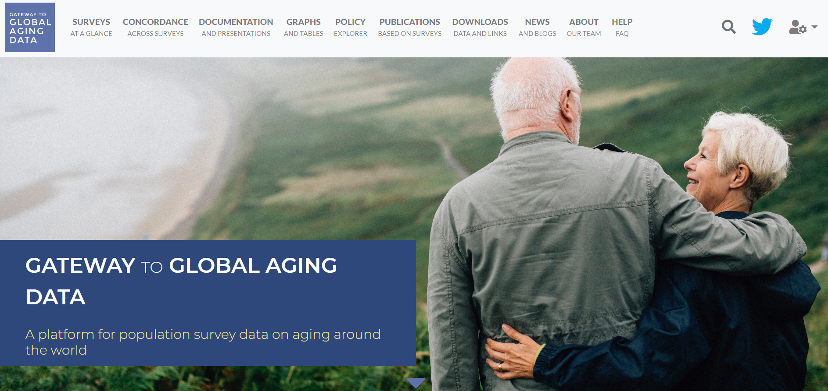
Data

Slide 6
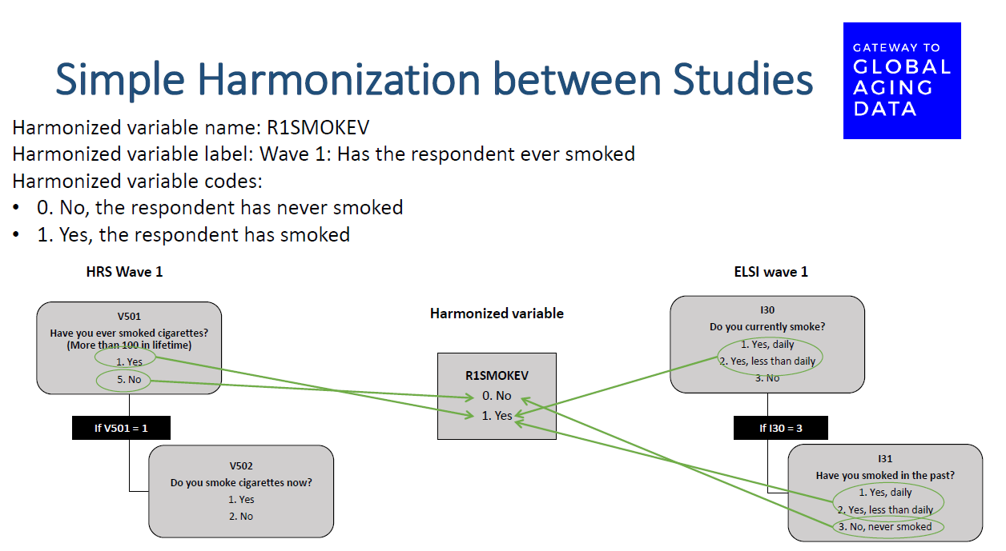
Source: Gateway to Global Aging Data, Produced by the Program on Global Aging, Health & Policy, University of Southern California with funding from the National Institute on Aging (R01 AG030153)

Slide 7
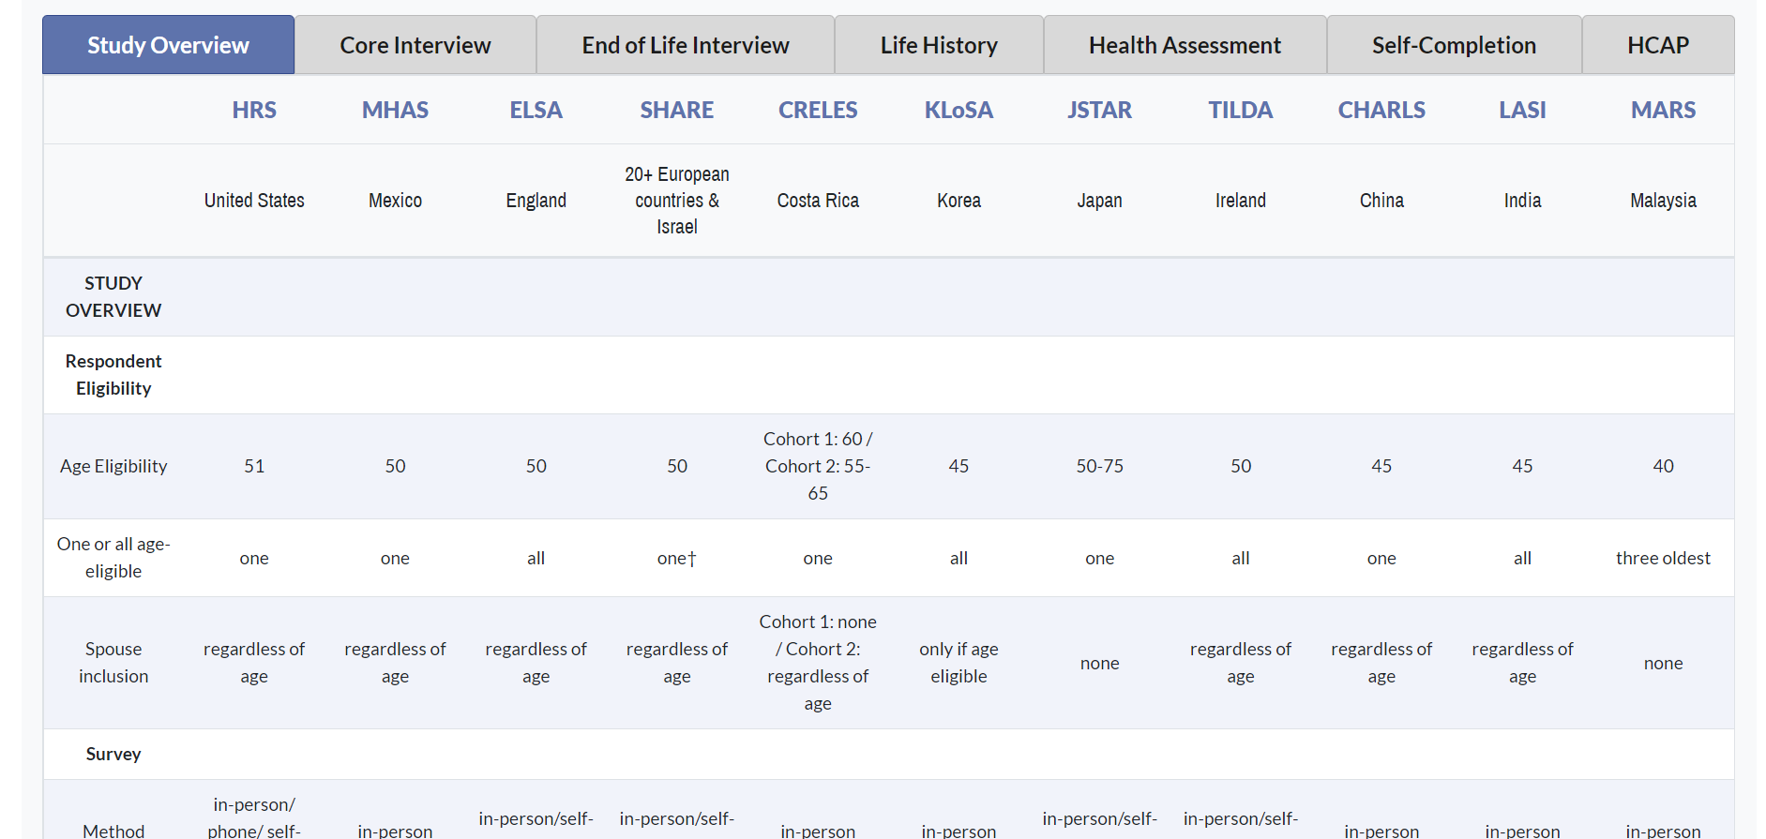
Source: Gateway to Global Aging Data, Produced by the Program on Global Aging, Health & Policy, University of Southern California with funding from the National Institute on Aging (R01 AG030153)

Slide 8
Concordance across surveys
Source: Gateway to Global Aging Data, Produced by the Program on Global Aging, Health & Policy, University of Southern California with funding from the National Institute on Aging (R01 AG030153)

Slide 9
Sample Characteristics
Number of Interviews/eligible respondents
Age >50
Non-institutionalized
Source: Gateway to Global Aging Data, Produced by the Program on Global Aging, Health & Policy, University of Southern California with funding from the National Institute on Aging (R01 AG030153)
9

Slide 10
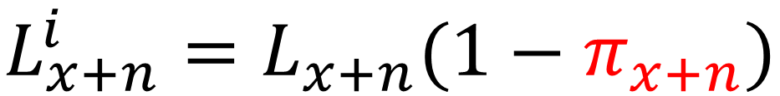
Methods Part I: disability-free life expectancy (DFLE) with Sullivan (1971)
total number of person-years lived in the age group x and x + n
$$L_{x+n}^{i}=L_{x+n}(1−π_{x+n})$$
proportion of disabled individuals in the age group x and x + n.
the number of person-years lived without disability between ages x and
x + n

Slide 11
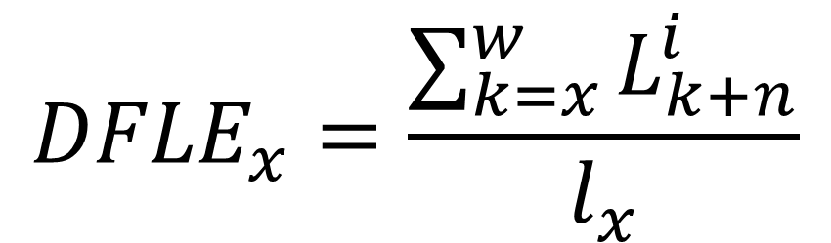
Methods Part I: disability-free life expectancy (DFLE) with Sullivan (1971)
Mortality data comes from:
United Nations
ONS for England
$${DFLE}_{x}=\frac{\sum_{k=x}^{w}{L_{k+n}^{i}}}{l_{x}}$$
$${∆{DFLE}_{x}=DFLE}_{x}^{Women}−{DFLE}_{x}^{Men}$$

Slide 12
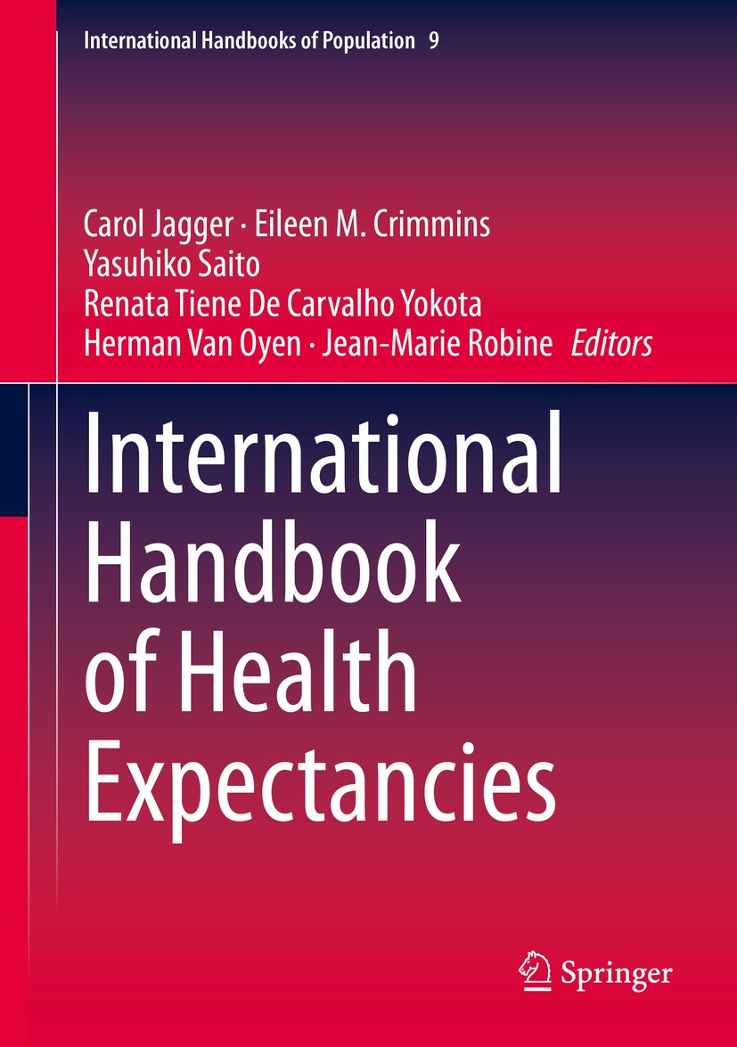
Methods Part II: Decomposing the gender gaps
Continuous change decomposition method (Horiuchi 2008)
Implemented in R by Riffe (2018).
Description van Raalte and Nepomuceno (2020).
Former application for the case of LAC countries (Nepomuceno, di Lego, Turra 2021)
Split the gender gap in DFLE into mortality and disability effects.

Slide 13
Results

Slide 14
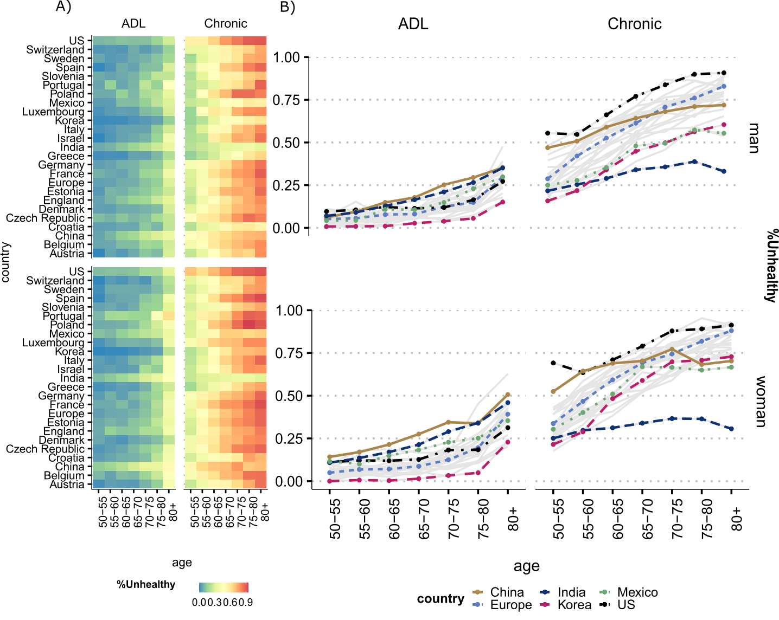

Slide 15
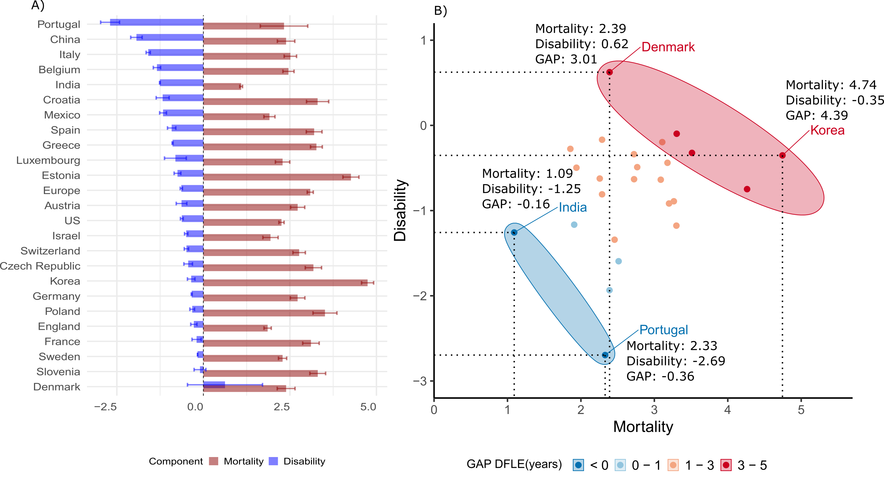

Slide 16
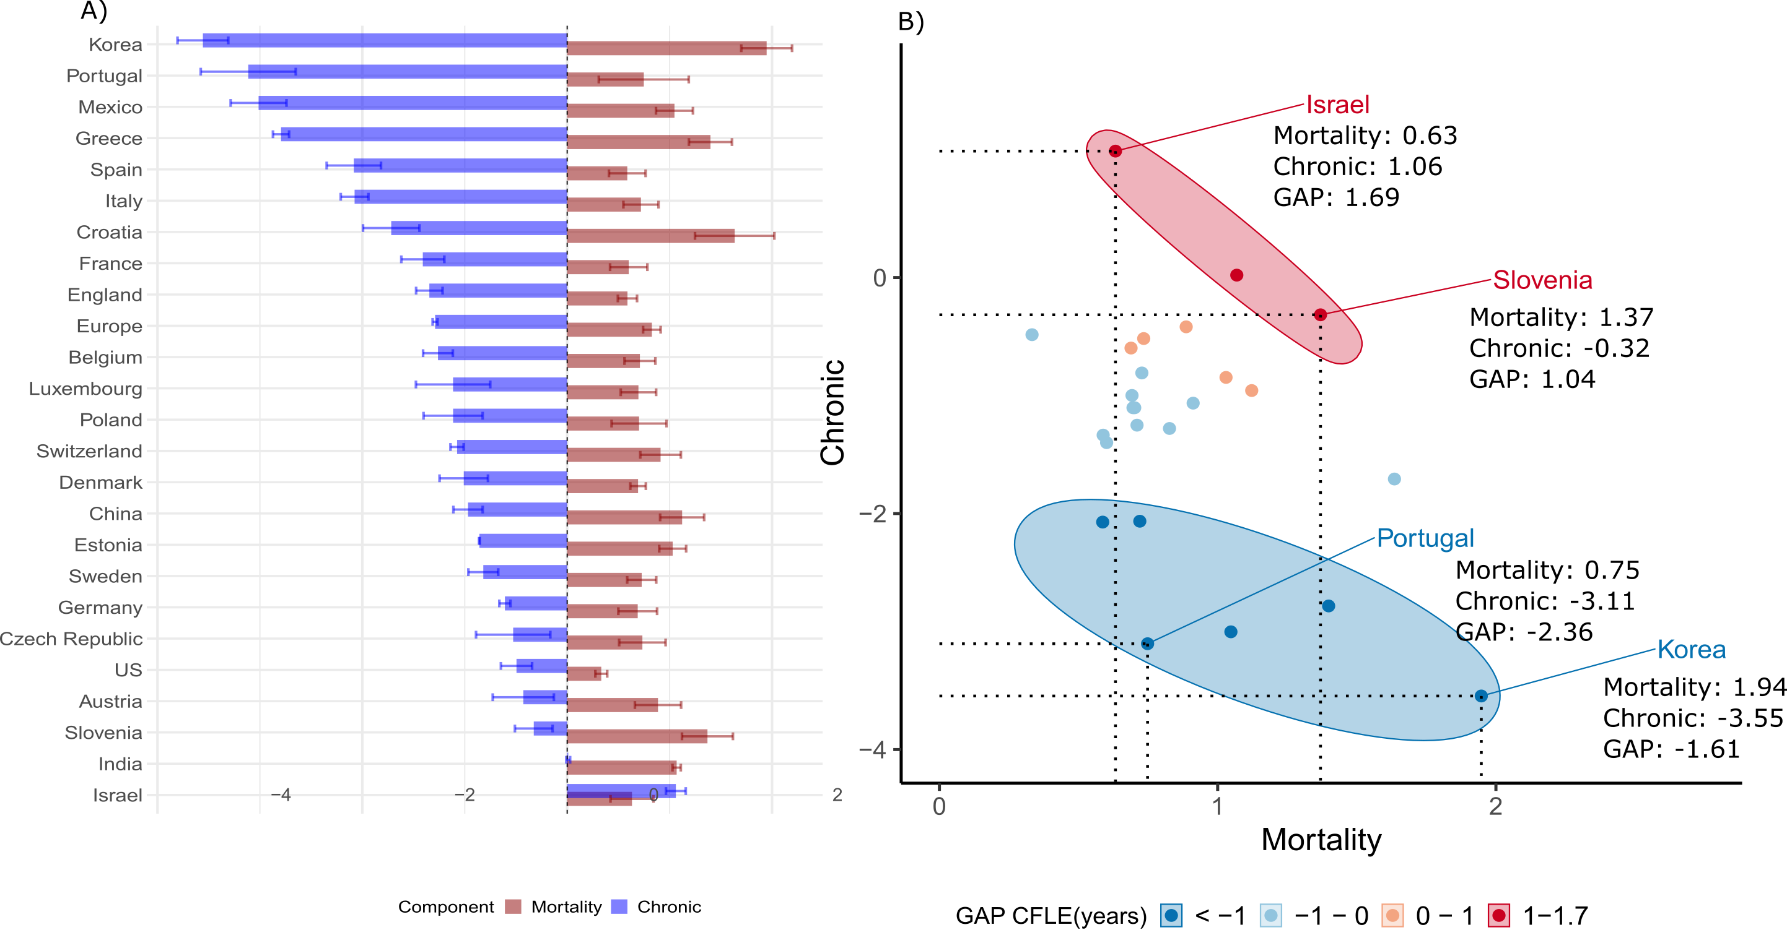

Slide 17
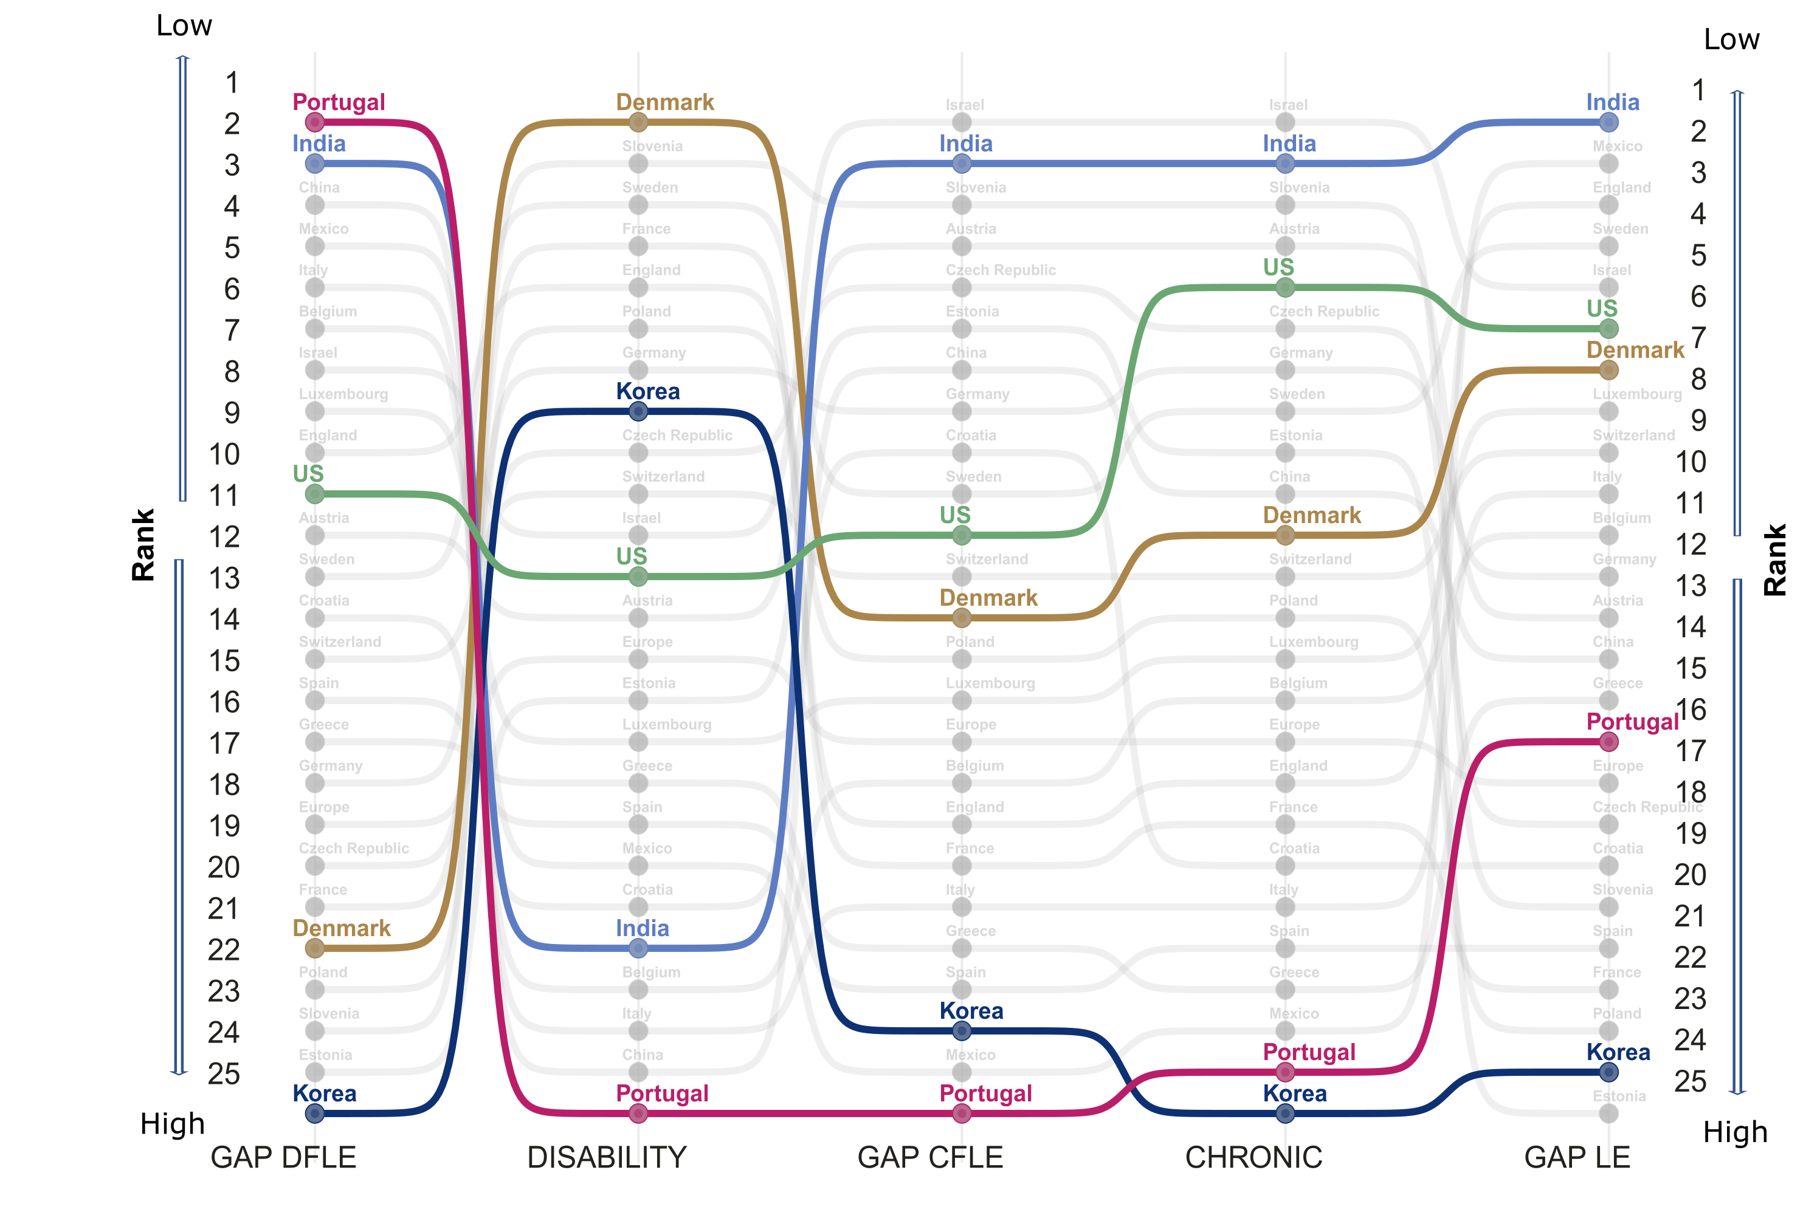

Slide 18
Source: Gateway to Global Aging Data, Produced by the Program on Global Aging, Health & Policy, University of Southern California with funding from the National Institute on Aging (R01 AG030153)

Slide 19
Source: Gateway to Global Aging Data, Produced by the Program on Global Aging, Health & Policy, University of Southern California with funding from the National Institute on Aging (R01 AG030153)

Slide 20
Source: Gateway to Global Aging Data, Produced by the Program on Global Aging, Health & Policy, University of Southern California with funding from the National Institute on Aging (R01 AG030153)

Slide 21
Source: Gateway to Global Aging Data, Produced by the Program on Global Aging, Health & Policy, University of Southern California with funding from the National Institute on Aging (R01 AG030153)

Slide 22
Source: Gateway to Global Aging Data, Produced by the Program on Global Aging, Health & Policy, University of Southern California with funding from the National Institute on Aging (R01 AG030153)

Slide 23
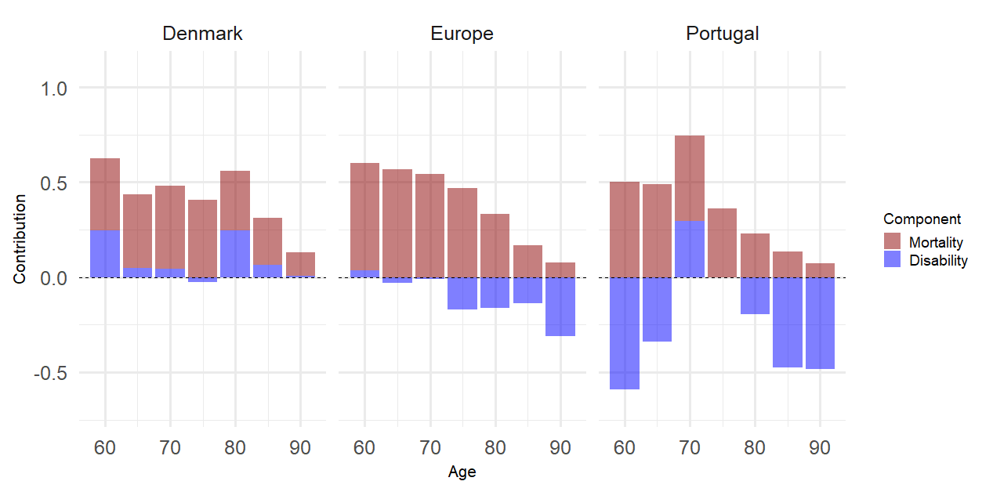
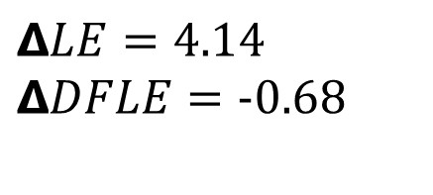
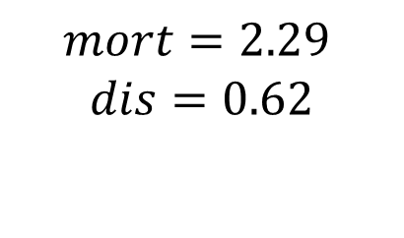
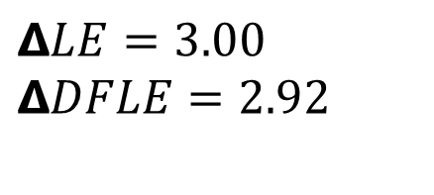
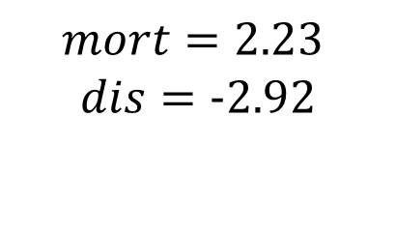
Figure 1. Contribution of Mortality and Disability to the Gender Gap in DFLE, by age
$$ΔLE=3.00$$
$$ΔDFLE=2.92$$
$$ΔLE=4.14$$
$$ΔDFLE=−0.68$$
$$mort=2.29$$
$$dis=0.62$$
$$mort=2.23$$
$$dis=−2.92$$
Source: Gateway to Global Aging Data, Produced by the Program on Global Aging, Health & Policy, University of Southern California with funding from the National Institute on Aging (R01 AG030153)

Slide 24
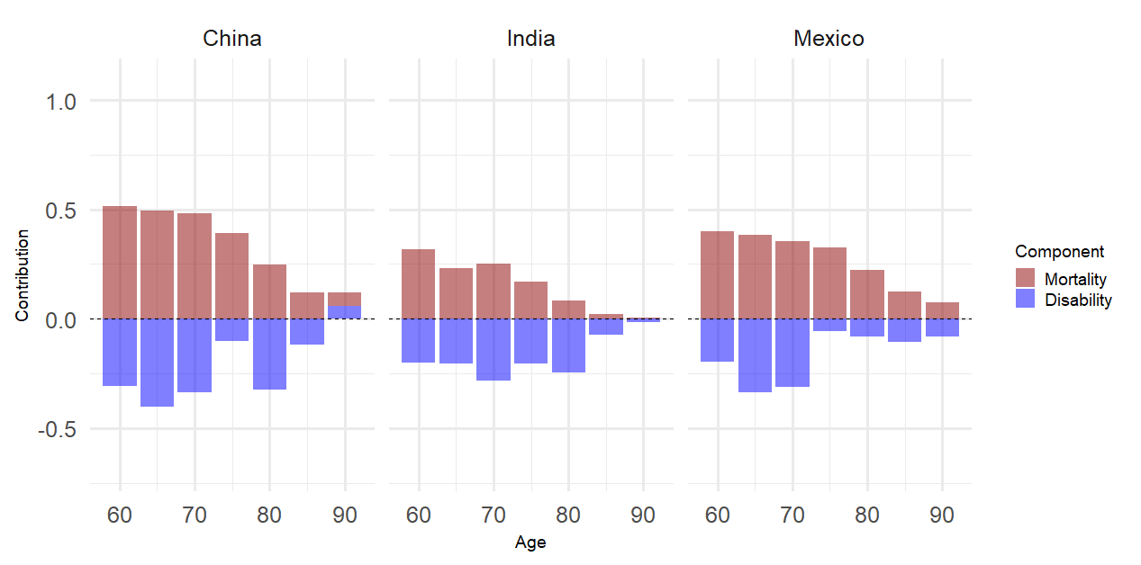
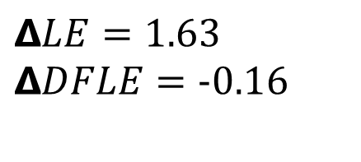
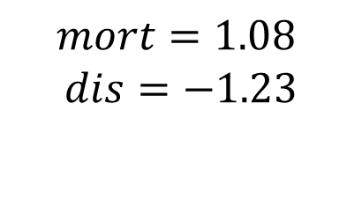
Figure 2. Contribution of Mortality and Disability to the Gender Gap in DFLE, by age
$$ΔLE=1.63$$
$$ΔDFLE=−0.16$$
$$mort=1.08$$
$$dis=−1.23$$
Source: Gateway to Global Aging Data, Produced by the Program on Global Aging, Health & Policy, University of Southern California with funding from the National Institute on Aging (R01 AG030153)

Slide 25
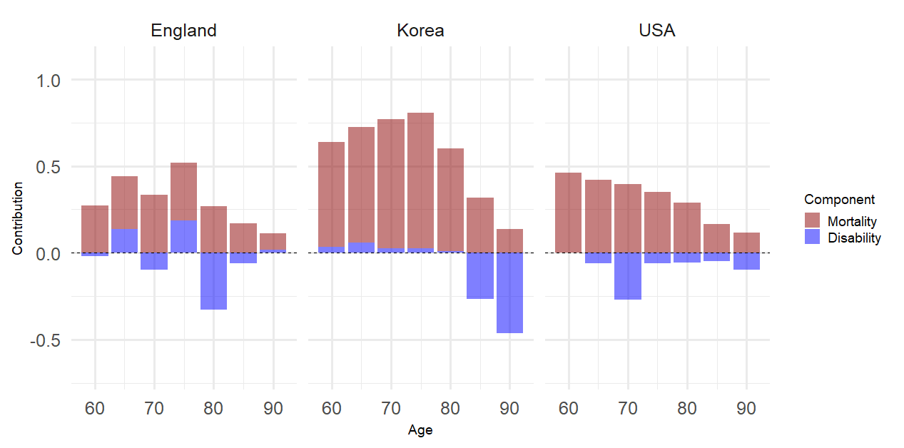
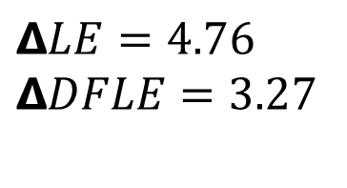
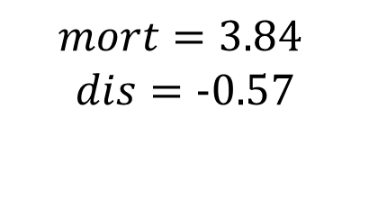
Figure 3. Contribution of Mortality and Disability to the Gender Gap in DFLE, by age
$$ΔLE=4.76$$
$$ΔDFLE=3.27$$
$$mort=3.84$$
$$dis=−0.57$$
Source: Gateway to Global Aging Data, Produced by the Program on Global Aging, Health & Policy, University of Southern California with funding from the National Institute on Aging (R01 AG030153)

Slide 26
Discussion, Limitations and Caveats
Gender differences in mortality and disability can be examined simultaneously by estimating and decomposing the gender gap in life expectancy.
The gap is important but does not tell the whole story – decomposing the gap is key.
Approach can be used to further investigate the male-female health survival gender paradox.
Cross-country comparisons are challenging but important to identify patterns and unpack gender differences in health and associations with Welfare State Systems, gender roles, etc.
!!ADLs are one dimension of health – important to include/analyse others
!!Sensitivity tests with other health dimensions and compare different sources for validity (SHARE-SILC for Europe, e.g.)

Slide 27
Thank you!
This research is funded by ERC grant n.725187
Levels and Trends of Health Expectancy: Understanding its Measurement and
Estimation Sensitivity
wittgensteincentre.org
dataexplorer.wittgensteincentre.org

